Slide 1

Network Analysis in MCH Practice
A brief introduction for public health practitioners
Lorie Wayne Chesnut, DrPH, MPH
University of Kentucky College of Public Health
The National MCH Workforce Development Center is funded by a cooperative agreement (#UE7MC26282) with the Health Resources & Services Administration Maternal & Child Health Bureau.
Notes:
Welcome. My name is Lorie Wayne Chesnut and this is a brief orientation to network analysis in MCH Practice. I am an Assistant Professor here at the University of Kentucky College of Public Health and have been a maternal and child health professional for about twenty years. Prior to my work here at the University of Kentucky in the Department of Epidemiology, I worked for the Kentucky Department for Public Health in a variety of programs, including the Title V MCH Block Grant. So I have a long history in the field and a practical view of the needs of state and local public health professionals.
I would like to acknowledge that this presentation was developed for the National MCH Workforce Development Center and was funded by a cooperative agreement with the Health Resources and Services Administration, Maternal and Child Health Bureau.

Slide 2
Learning Objectives
Participants will be able to:
Define network analysis and understand basic terminology associated with this technique
Explain the role of network analysis in public health practice
Discuss applications for maternal and child health programs
Identify resources available to MCH practitioners
Notes:
First, let’s discuss the learning objectives for this course. Following the completion of this presentation, participants will be able to: 1. define network analysis and understand basic terminology associated with this technique. 2. Explain the role of network analysis in public health practice. 3. Discuss application for maternal and child health programs and 4. Identify resources available to MCH practitioners specific to network analysis software and programs.

Slide 3
Suggested Reading:
Provan KG, Veazie MA, Staten LK and Teufel-Shone NI. (2005). The Use of Network Analysis to Strengthen Community Partnerships. Public Administration Review. Vol 65 (5):603-613.
This is a very clear and interesting introduction to the basic terminology and components of network analysis, written in a format that will be familiar to public health professionals at all levels of practice.
Notes:
Before we begin, I would like to suggest this article by Provan et al. entitled “The Use of Network Analysis to Strengthen Community Partnerships” which provides a very clear and readable review of network analysis with practical applications to public health. This article provides a pragmatic introduction to network analysis and potential benefits for both the program or organization of interest and the community as a whole. As of Fall 2014 it was available on the internet in a variety of locations and you will find it on the Transformation Station site under the “Systems” Core.

Slide 4
Why Network Analysis?
Health reform efforts reflect the need to partner with new and varied collaborators.
MCH leaders want to be “at the table” to protect the interests of MCH populations.
Understanding basic network science principles allow MCH public health practitioners to take a leading role as they address new and familiar challenges in their daily activities. We want to lead, not follow!
A Snapshot of Current Title V Workforce Needs. Web link: http://www.amchp.org/Transformation-Station/Pages/Home.aspx
Notes:
In an era of health care reform, partnerships play an important role as MCH leadership sits at the table with colleagues from Medicaid, private medical and health insurance providers. We learned, through the needs assessment process in 2014, that skills to create and enhance partnerships and collaborations were more important than ever to Title V leadership. Public health must be “at the table” early and consistently. We want to assure care for the women, infants and children under our care and we want to lead these changes, not passively follow the lead of others. Understanding the basic tenants of network science principles can provide us with tools to enhance our skills. This, in turn, directly benefits our families.

Slide 5
Network Analysis Defined
“Network analysis is a method of collecting and analyzing data from multiple individuals or organizations that may be interacting with one another”.
Provan KG, Veazie MA, Staten LK, and Teufel-Shone NI. (2005). The Use of Network Analysis to Strengthen
Community Partnerships. Public Administration Review. 65(5):603-613.
Notes:
Provan et al states that: “Network analysis is a method of collecting and analyzing data from multiple individuals or organizations that may be interacting with one another.” Our focus for this presentation is on programs and partnerships, particularly in light of changes needed under health care reform. Collaboration is key and while maternal and child health practitioners have always worked together to implement change, the breadth of our partnerships is expanding further than ever before.

Slide 6
Network analysis – used to …
  Visualizing connections between people, organizations, relationships
  HIV and STD research to understand the spread of disease across communities
  Understanding “Dark Networks” (terrorist organizations), which are studied as organizations, with a focus on identifying and understanding weak links which can then be targeted
  Nodes are represented here by circles while links are represented by the lines that connect them.
Triad (blue)
Dyad (green)
Isolate
Fragile Connection
Notes:
But network analysis can be used to understand the behavior of other groups, including networks of drug users (who buys, who sells and how often), the spread of sexually-transmitted disease among a group of peers and “dark networks” - terrorist organizations. In all of these examples, it is important to understand who connects to whom and where strong or particularly weak links exist.
Nodes are represented here by circles while links are represented by the lines that connect them. Nodes can be people, or even different kinds of people (i.e., providers and patients). They can represent agencies, resources, or tasks that need to be done. Links connect nodes in some meaningful way. For example, two people might be linked if they are friends or share information, or have a sexual partnership. Links can go one way (i.e., an organization can have access to a resource, or a person can be assigned to a task) or two ways (two agencies collaborate). Visualizing networks can allow a different kind of conversation around how they behave, and how to improve them. One can stop with visualization, or, if warranted by the problem, continue to more sophisticated analysis.

Slide 7
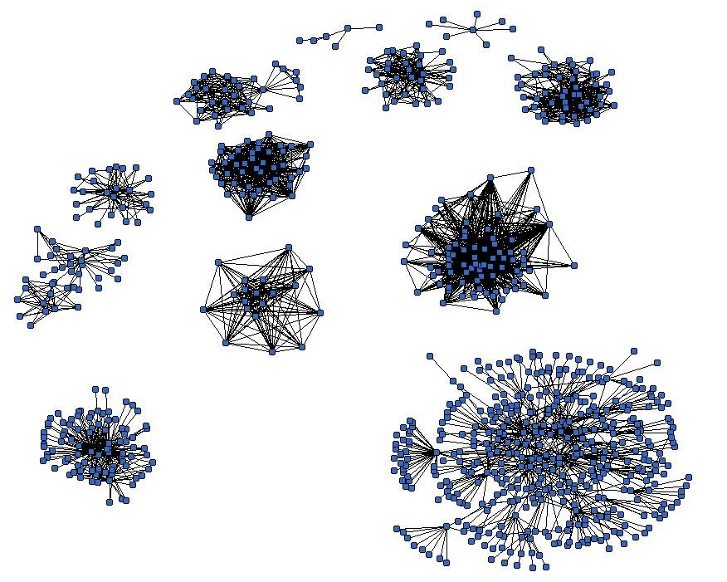
Network Mapping & Analysis
Networks Vary in Size, Shape and Composition
From very small
to very large, simple to complex
Note: From the presentation “Evaluating Networks: Social Network Analysis” by DM Varda, 2014, University of Colorado Denver School of Public Affairs. Reprinted with permission.
Notes:
As illustrated by Dr. Danielle Varda of the University of Colorado Denver, networks can be very simple (at the top of this slide you will see some simple networks with 6 or 7 partners) or very complex, as illustrated in the lower right hand corner with potentially hundreds of nodes and complex interconnections.

Slide 8
Evaluating Your Network: Terms to Know
Density: How connected are the nodes in your network? What is their level of connectedness? How often do they interact?
Centrality: Who is at the center of the network? One or more organizations? Should someone be at the center who is not?
Weak or Strong Ties: Who is strongly linked and where are weak or fragile links? Weak or fragile links can easily be broken.
Fragmentation: Is your overall system strongly connected or do you have fragments or isolates within your network?
Trust: What is the level of trust within your network? How well do individuals or organizations work together?
Provan KG, Veazie MA, Staten LK, and Teufel-Shone NI. (2005). The Use of Network Analysis to Strengthen
Community Partnerships. Public Administration Review. 65(5):603-613
Notes:
Let’s talk about some important terms to know when evaluating a network. This and more can be found from the Provan et al. paper entitled “The Use of Network Analysis to Strengthen Community Partnerships”.
Density: How connected are the nodes in your network? What is their level of connectedness? How often do they interact?
Centrality: Who is at the center of the network? One or more organizations? Should someone be at the center who is not?
Weak or Strong Ties: Who is strongly linked and where are weak or fragile links? Weak or fragile links can easily be broken.
Fragmentation: Is your overall system strongly connected or do you have fragments or isolates within your network?
Trust: What is the level of trust within your network? How well do individuals or organizations work together?
Now let’s look at little more closely at each of these terms.

Slide 9
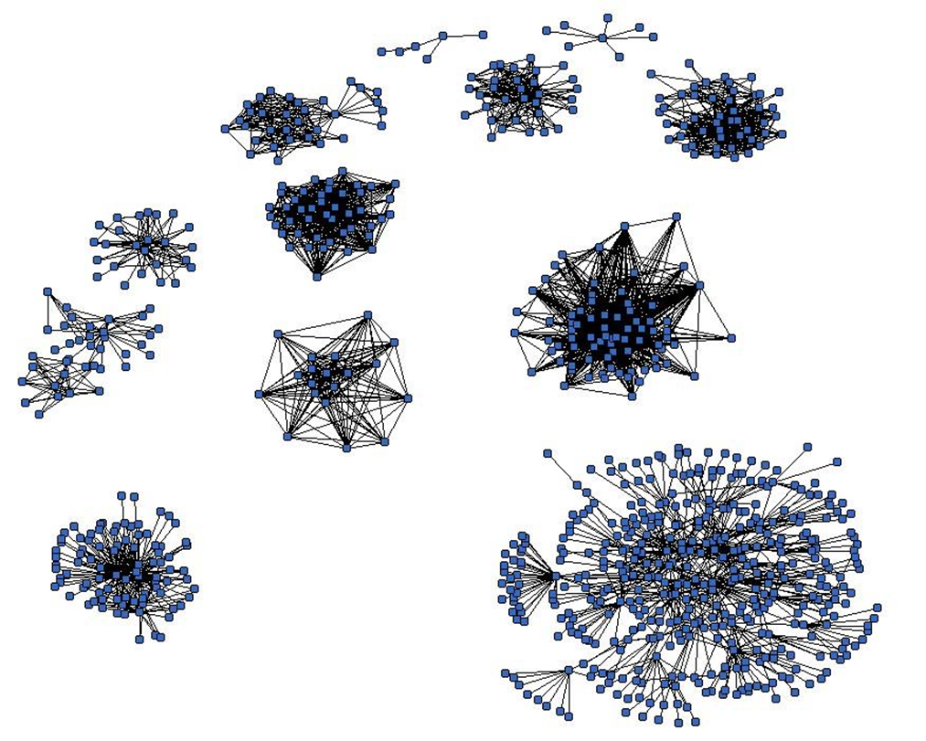
Density
How connected are the nodes in your network? What is their level of connectedness? How often do they interact with one another?
This doesn’t tell us about the quality of the connections – just an understanding of what ties exist in relation to all that could exist.
Provan KG, Veazie MA, Staten LK, and Teufel-Shone NI. (2005). The Use of Network Analysis to Strengthen
Community Partnerships. Public Administration Review. 65(5):603-613
Illustration from the presentation “Evaluating Networks: Social Network Analysis” by DM Varda, 2014, University of Colorado Denver School of Public Affairs. Reprinted with permission.
Notes:
How connected are the nodes in your network? What is their level of connectedness? How often do they interact with one another?
This doesn’t tell us about the quality of the connections – just an understanding of what ties exist in relation to all that could exist. You can see in the illustration how many connections exist at the center of this network but how loosely tied those individuals or agencies on the periphery of the network seem to be. For some networks, this might be an workable arrangement but for others, more ties might be beneficial.
Dr. Danielle Varda, the developer of PARTNER, which we’ll talk about later in this presentation, teaches that a bigger network isn’t always a better network. We need to right-size, making sure that each partner has a role to play and adds to the network as a whole. Trimming the network can sometimes make for a more efficient and manageable system. Each network is unique.
For a concise overview of Density, see “The Use of Network Analysis to Strengthen Community Partnerships” by Provan and colleagues.

Slide 10
Centrality
Who is at the center of the network? One or more organizations? Should someone be at the center who is not? Central position frequently represents power in a network, controlling resources and information.
Who is least central? If someone falls on the perimeter of your network but hold a critical role in the network, the reason for this should be examined.
Provan KG, Veazie MA, Staten LK, and Teufel-Shone NI. (2005). The Use of Network Analysis to Strengthen
Community Partnerships. Public Administration Review. 65(5):603-613
Illustration from the presentation “Evaluating Networks: Social Network Analysis” by DM Varda, 2014, University of Colorado Denver School of Public Affairs. Reprinted with permission.
Notes:
Who is at the center of the network? One or more organizations? Should someone be at the center who is not? Central position frequently represents power in a network, controlling resources and information.
Who is least central? If someone falls on the perimeter of your network but hold a critical role in the network, the reason for this should be examined.
For a concise overview of Centrality, see “The Use of Network Analysis to Strengthen Community Partnerships” by Provan and colleagues.

Slide 11
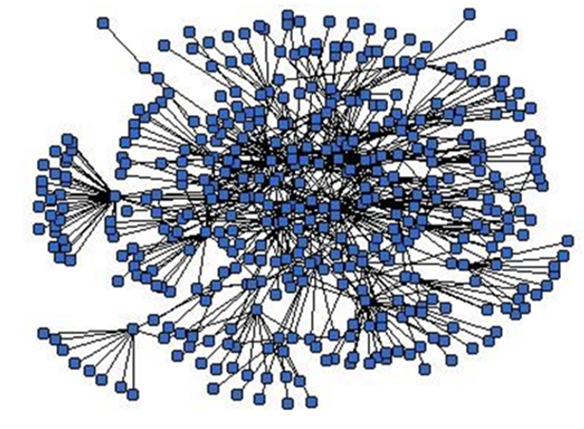
Weak or Strong Ties?
Who is strongly linked and where are weak or fragile links? Weak or fragile links can easily be broken.
Illustrated at right, the red circles show areas of weak linkages, where one agency or individual is the sole link to the network. Should this group or person leave the network, multiple connections would be lost.
Further toward the inside of the network, agencies or individuals appear to be strongly connected.
Provan KG, Veazie MA, Staten LK, and Teufel-Shone NI. (2005). The Use of Network Analysis to Strengthen
Community Partnerships. Public Administration Review. 65(5):603-613
Illustration from the presentation “Evaluating Networks: Social Network Analysis” by DM Varda, 2014, University of Colorado Denver School of Public Affairs. Reprinted with permission.
Notes:
Who is strongly linked and where are weak or fragile links? Weak or fragile links can easily be broken.
Illustrated at right, the red circles show areas of weak linkages, where one agency or individual is the sole link to the network. Should this group or person leave the network, multiple connections would be lost. Should these connections be strengthened? How important are they to your group?
Further toward the inside of the network, agencies or individuals appear to be strongly connected. We need to consider how sustainable over time these ties are for your network. Many networks come and go before they can adequately finish their work. Understanding where weak links may exist help us to make decisions about sustainability and address needs if they exist.
For a concise overview of Weak versus Strong ties and how they can effect a network, read “The Use of Network Analysis to Strengthen Community Partnerships” by Provan and colleagues.

Slide 12
Fragmentation and Isolates
Is your overall system strongly connected or do you have fragments or isolates within your network?
Perhaps you have critical partners that don’t routinely interact with your network? Or perhaps two integrally connected partners that only work with one another and are not formally connected within a collaboration or partnership? What benefits could they bring if their ties to the whole were strengthened?
Network analysis allows you to identify isolates or fragments in a network before critical time, relationships and resources are lost.
Provan KG, Veazie MA, Staten LK, and Teufel-Shone NI. (2005). The Use of Network Analysis to Strengthen
Community Partnerships. Public Administration Review. 65(5):603-613
Notes:
Is your overall system strongly connected or do you have fragments or isolates within your network?
Perhaps you have critical partners that don’t routinely interact with your network? Or perhaps two integrally connected partners that only work with one another and are not formally connected within a collaboration or partnership? What benefits could they bring if their ties to the whole were strengthened?
Network analysis allows you to identify isolates or fragments in a network before critical time, relationships and resources are lost.
For a more detailed overview of fragmentation and isolates and how these can affect your network, read “The Use of Network Analysis to Strengthen Community Partnerships” by Provan and colleagues.

Slide 13
Trust
What is the level of trust within your network? How well do individuals or organizations work together?
Networks can accomplish more as a group than single individuals could hope to accomplish by themselves. Yet trust is an integral part of our success. Relationships must be built early and kept stable over time. We know that this is not an easy accomplishment.
Trust can be measured through network analysis and an overall trust score compiled for network participants.
Provan KG, Veazie MA, Staten LK, and Teufel-Shone NI. (2005). The Use of Network Analysis to Strengthen
Community Partnerships. Public Administration Review. 65(5):603-613
Notes:
What is the level of trust within your network? How well do individuals or organizations work together? Networks can accomplish more as a group than single individuals could hope to accomplish by themselves. Yet trust is an integral part of our success. Relationships must be built early and kept stable over time. We know that this is not an easy accomplishment.
Trust can be measured through network analysis and an overall trust score compiled for network participants. Trust and its importance to networks is discussed at length in the article by Provan and colleagues.

Slide 14
Why Network Analysis?
Provan and colleagues raise these key questions that network analysis may help to answer:
Which agencies are most or least central to the network? Are these positions the correct ones based upon their contribution to the whole?
What network members may have critical links to important resources that might benefit the whole?
Are ties based upon personal relationships or are they sustainable over time?
Are relationships strong or weak? If weak, do we really need them these ties (right-size). If the answer is yes, they may need to be strengthened.
What groups or individuals already have strong working relationships? Could their cohesiveness benefit the entire network?
Looking over time, has progress been made in capacity-building efforts?
What is the level of trust in the network? Does trust need to be strengthened?
Provan KG, Veazie MA, Staten LK, and Teufel-Shone NI. (2005). The Use of Network Analysis to Strengthen
Community Partnerships. Public Administration Review. 65(5):603-613
Notes:
Provan and colleagues raise these key questions that network analysis may help to answer:
Which agencies are most or least central to the network? Are these positions the correct ones based upon their contribution to the whole?
What network members may have critical links to important resources that might benefit the whole?
Are ties based upon personal relationships or are they sustainable over time?
Are relationships strong or weak? If weak, do we really need them these ties (right-size). If the answer is yes, they may need to be strengthened.
What groups or individuals already have strong working relationships? Could their cohesiveness benefit the entire network?
Looking over time, has progress been made in capacity-building efforts?
What is the level of trust in the network? Does trust need to be strengthened?
We can see applications for network analysis to help us build and sustain critical partnerships in response to health reform changes and the evolving nature of public health practice. All states and communities can benefit from an understanding of these principles and strategies.

Slide 15
Why Network Analysis?
And one more critical question:
“What are the benefits and drawbacks of collaboration, have these changed over time, and how can benefits be enhanced and drawbacks minimized?”
- Provan et al, 2005
Your time, as an MCH public health leader, is valuable. There is no extra time for meetings that go nowhere, projects that never come to fruition, or programs that don’t result in the outcomes that they promise.
The ongoing use of network analysis can clue us into critical needs that might undermine our best intentions and efforts as we participate in networks, partnerships and collaborations to improve the health of mothers, infants, children and families in our communities.
Provan KG, Veazie MA, Staten LK, and Teufel-Shone NI. (2005). The Use of Network Analysis to Strengthen
Community Partnerships. Public Administration Review. 65(5):603-613
Notes:
And one more critical question:
“What are the benefits and drawbacks of collaboration, have these changed over time, and how can benefits be enhanced and drawbacks minimized?”
Provan et al, 2005
Your time, as an MCH public health leader, is valuable. There is no extra time for meetings that go nowhere, projects that never come to fruition, or programs that don’t result in the outcomes that they promise.
The ongoing use of network analysis can clue us into critical needs that might undermine our best intentions and efforts as we participate in networks, partnerships and collaborations to improve the health of mothers, infants, children and families in our communities.

Slide 16
A Practical Example for MCH Practitioners
Note: Visual from the presentation “Evaluating Networks: Social Network Analysis” by DM Varda, 2014, University of Colorado Denver School of Public Affairs. Reprinted with permission.
Notes:
Before we go further, let’s talk about a practical example that you, as a public health professional, might encounter. This is a hypothetical example but one that could occur in a state health department setting.

Slide 17
Part C Network
A state-wide provider and parent network has been in place for over ten years to review and coordinate services for infants and young children enrolled in Part C Early Intervention programs.
Over time, meeting attendance has declined and concern exists that the utility of the partnership, as it exists today, has also declined. Families complain that services received are not optimal and that they don’t feel that they have a voice at the table. Critical partners are not at the table. Health reform has also complicated service delivery, allocations and payment options for these families. As the Title V Director, you are concerned about services and resources for families under Part C.
To help them understand the problem, planners decide to use network analysis to evaluate their current network.
Notes:
A state-wide provider and parent network has been in place for over ten years to review and coordinate services for infants and young children enrolled in Part C Early Intervention programs.
Over time, meeting attendance has declined and concern exists that the utility of the partnership, as it exists today, has also declined. Families complain that services received are not optimal and that they don’t feel that they have a voice at the table. Critical partners are not at the table. Health reform has also complicated service delivery, allocations and payment options for these families. As the Title V Director, you are concerned about services and resources for families under Part C.
To help them understand the problem, planners decide to use network analysis to evaluate their current network.

Slide 18
Network Analysis Example
Service Providers
Parent Representatives
Family Voices
State Pediatric Society
Early Childhood Mental Health
Dept. of Education
CSHCN
Well Child / EPSDT
Medicaid/CHIP
Home Visitation Program
Part C
Title V
Early Head Start
Immunization Program
Part C Early Intervention Network (current)
Dept. of Social Services
Notes:
What we see here are “nodes” (these are shown as boxes, not circles, in this example) representing various groups that might be part of an Early Intervention Network. These include parent and provider representatives, the CSHCN agency, Medicaid/Chip programs and Title V among others. Title V seems to be well represented, including early childhood programs, home visiting and others.
However, we can see that our Title V providers are well connected to one another but not to our Part C program. Only one link exists that connects Title V with Part C. This might represent one particular person. If that person leaves his or her position, there is a risk that the entire connection to Title V would be lost.
The same is true for the link between the CSHCN program and Part C. Service providers are completely unconnected to the system as is the Department of Education. It is no wonder that service providers feel isolated. And what benefits might the Part C program be missing due to the isolation of the Department of Education in their state?
If we analyzed this network today and every other year, imagine what we could learn about the way our network functions – and how we could improve that function by understanding its limitations or strengths.

Slide 19
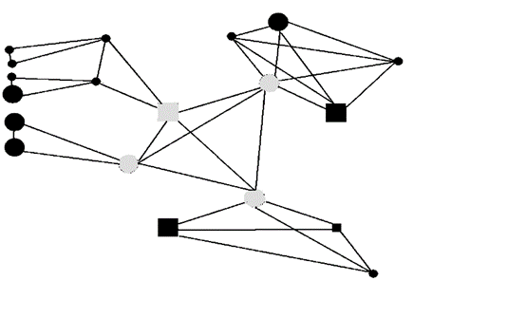
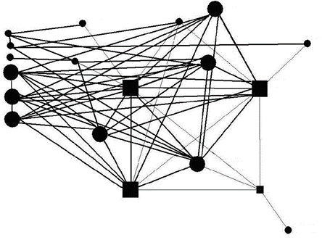
Network Analysis Example
Through network analysis we can understand …
  If gaps, vulnerabilities and inefficiencies exist among partnerships
  How well people are using scarce public dollars through collaborations
  How effective our network has been over time
  What network ties are strong or weak
  The density (level of connectedness) and centrality (who is at the center) of our network
  How much our network members trust one another
Understand Subgroups
Increase Density
Note: From the presentation “Evaluating Networks: Social Network Analysis” by DM Varda, 2014, University of Colorado Denver School of Public Affairs. Reprinted with permission.
Notes:
Through the use of network analysis, we can understand
If gaps, vulnerability and inefficiencies exist within our partnerships
How well we are using scarce public health funding through our collaborations
How effective our network has been over time
What network ties are strong or weak
How dense our network is (how connected we are) and who is at the center of our network
How much our network members trust one another
These are all important considerations for networks, partnerships and collaborations over time.

Slide 20
Network Analysis Resources for Public Health Practitioners
Note: Visual from the presentation “Evaluating Networks: Social Network Analysis” by DM Varda, 2014, University of Colorado Denver School of Public Affairs. Reprinted with permission.
Notes:
Now let me provide you with some resources. We will discuss PARTNER, a tool that is available for you from the University of Colorado Denver and several programs that can be purchased as well as some that are available at no cost if you prefer to analyze your networks independently.

Slide 21
The PARTNER Tool
PARTNER: Program to Analyze, Record and Track Networks to Enhance Relationships
Developed by Danielle Varda, PhD, Associate Professor at the School of Public Affairs, University of Colorado Denver
A social network analysis tool to collect, analyze and interpret data to improve collaboration within community networks
Trainings (on-line and in-person) and support are available
How long does the PARTNER process take from start to finish? It depends …
Notes:
PARTNER stands for Program to Analyze, Record and Track Networks to Enhance Relationships. This tool was developed by Dr. Danielle Varda of the School of Public Affairs, University of Colorado, Denver. It is a social network analysis tool to collect, analyze and interpret data to improve collaboration within community networks.
Support and trainings are available from PARTNER. A basic orientation to the tool is free on-line with more enhanced support available for a modest fee. Public agencies can use the tool for a modest $ 50.00 fee (for a one-time use) and students can use the tool for only $ 25.00. PARTNER uses Excel – a program that most know and use frequently. PARTNER is very easy to use and is a great addition to the public health professional’s toolbox. Epidemiologists, in particular, would really enjoy this program and it would significantly add to their skills sets.
I’ve been asked to tell you how long the process of network analysis is when PARTNER is used. It depends, of course, upon your network, its size and complexity.
The first two steps are the most time-consuming. The first step (after initially orienting to PARTNER) is the selection of individuals in your network who will be send a survey that PARTNER can help you develop. This is called “bounding the network” – understanding who participates and collecting this information. The second step is modifying the survey tool. PARTNER provides you with a template that you can modify based upon your needs and questions. Again, those working with PARTNER can access guidance on both their website and from the PARTNER team. Making sure that your questions are the RIGHT questions may be the most challenging part of the network analysis process. From that point on, you upload your contacts to the PARTNER tool and send out the survey. The system monitors feedback and you can review response rates. As with any survey, your job is to make sure your response rate is as high as possible which may mean contacting your network membership if they do not respond. Once your membership has responded, PARTNER provides a basic analysis to you. For a moderate additional fee, you can receive an in-depth report that PARTNER creates for you and your network.
If someone was experienced with using the tool, had a moderately sized network and focused primarily on this task, the turn-around time from conception to results could be as little as two weeks. Dr. Varda emphasized that this is a thinking exercise and that it is important not to rush through the process. Making sure that your questions are the RIGHT questions is key to getting valid results.

Slide 22
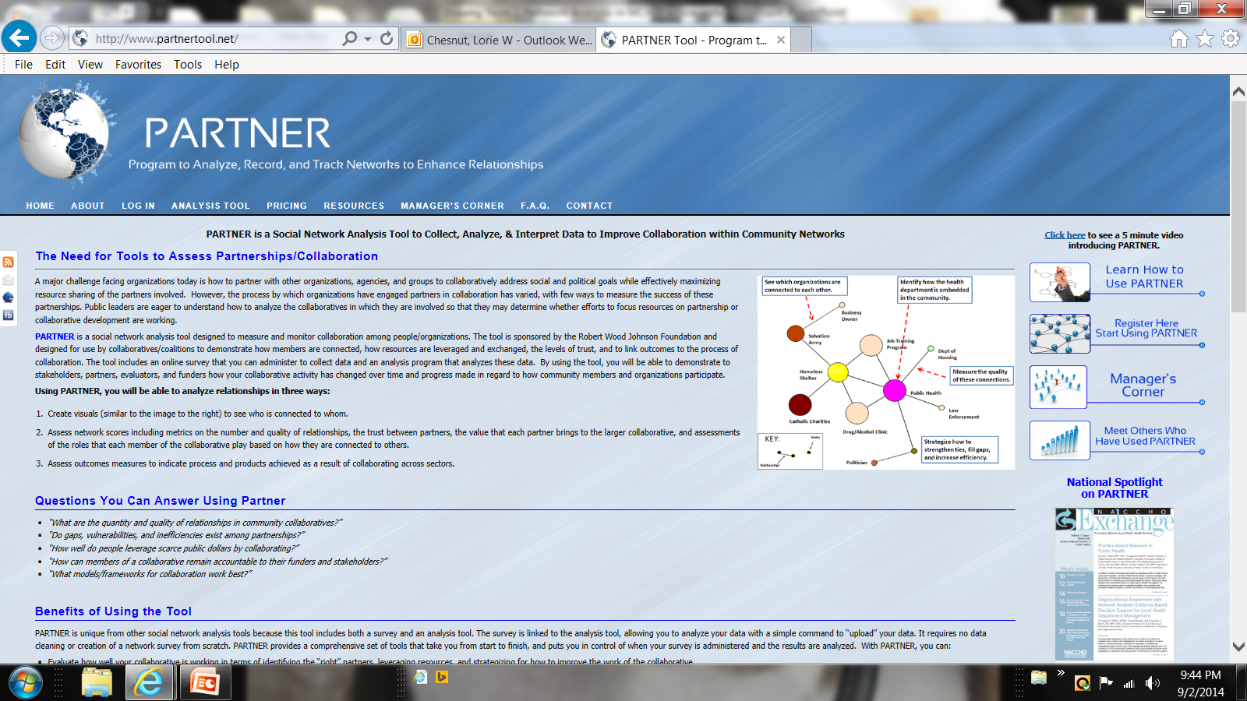
PARTNER: http://www.partnertool.net/
Notes:
I’ve provided you with a link to PARTNER – I hope that you take some time to visit the website and explore the many resources available to public health professionals who use this program. At the upper right corner you will see a yellow star. Right beside this is a link to see a short video that introduces you to PARTNER. Other resources such as connections to those who have used PARTNER, free on-line trainings and a conference (held annual in May) are available. PARTNER staff will consult with you for an additional fee or even provide an on-site training for interested staff. Early work by Dr. Varda to develop PARTNER was supported by the Robert Wood Johnson Foundation.

Slide 23
More Readings
For those of you who might like to read more about the role of network analysis in MCH, here is a publicly available article by Dr. Varda specific to Children with Special Health Care Needs and their systems of care:
Varda, Danielle M. and Talmi, Ayelet (2013) "A Patient-Centered Approach for Evaluating Public Health Roles within Systems of Care for Children with Special Healthcare Needs," Frontiers in Public Health Services and Systems Research: Vol. 2: No. 1, Article 7.
Available at: http://uknowledge.uky.edu/frontiersinphssr/vol2/iss1/7/
Notes:
For those of you who might like to read more about the role of network analysis in MCH here is a publicly available article by Dr. Varda specific to Children with Special Health Care Needs and their systems of care:
Varda, Danielle M. and Talmi, Ayelet (2013) "A Patient-Centered Approach for Evaluating Public Health Roles within Systems of Care for Children with Special Healthcare Needs," Frontiers in Public Health Services and Systems Research: Vol. 2: No. 1, Article 7.
Available at: http://uknowledge.uky.edu/frontiersinphssr/vol2/iss1/7/

Slide 24
Some Additional Resources
Gephi – an open-source and multiplatform software to help us explore and understand graphs and visualizations. Learn more at: http://gephi.github.io/features/
Pajek* – a program for Windows to analyze and visualize large networks. Freely available for noncommercial use. Learn more at: http://pajek.imfm.si/doku.php?id=pajek
UCINET – a software package for the analysis of social network data. Learn more at: https://sites.google.com/site/ucinetsoftware/home
*“Pajek” is the word for “spider” in Slovene, the official language of the Republic of Slovenia. Note: Links active as of 09/13/2014.
Notes:
Gephi is a free, open-source software that helps us explore and understand graphs and visualizations. It goes hand-in-hand with statistics to help us analyze data through visualization. We’ve provided you with the link to the website which also has a video to introduce the software.
Pajek, developed for Windows, is also freely available for noncommercial use to analyze and visualize large networks. We’ve provided you a link to this website which is full of information for both the new and experienced user. Pajek is developed by Vladimir Batagelj and Andrej Mrvar.
UCINET is another popular software used for the analysis of social network data developed by Freeman, Everett and Borgatti. UCINET is available for a free 90-day download and for the reasonable fee of $ 150.00 for government users.
Many other network analysis software packages exist – explore the resources available for social network analysis tools. All of these software packages and others fit nicely with the epidemiologists “toolbox” and that of others who are interested in network analysis. Of course, with new programs comes the need for training – so this should be considered in the planning process.

Slide 25
Articles for additional reading
Provan KG, Veazie MA, Staten LK and Teufel-Shone NI. (2005). The Use of Network Analysis to Strengthen Community Partnerships. Public Administration Review. 65(5):603-613.
Provan KG and Milward HB. (2001). Do Networks Really Work? A Framework for Evaluating Public Sector Organizational Networks. Public Administration Review. 61(4):400-409
Varda, Danielle M. (2011). “Data-Driven Management Strategies in Public Health Collaboratives”, Journal of Public Health Management and Practice, 17(2), 122-132.
Varda DM, Forgette R, Banks D, Contractor N. (2009). Social Network Methodology in the Study of Disasters: Issues and Insights Prompted by Post-Katrina Research. Popul Res Policy Rev. 28:111-29. DOI 10.1007/s111113-008-9110-9
Notes:
There are many excellent papers addressing the value of network analysis as a tool for understanding community networks, partnerships and coalitions. Above are just a few examples to help you begin. They are:
Provan KG, Veazie MA, Staten LK and Teufel-Shone NI. (2005). The Use of Network Analysis to Strengthen Community Partnerships. Public Administration Review. 65(5):603-613.
Provan KG and Milward HB. (2001). Do Networks Really Work? A Framework for Evaluating Public Sector Organizational Networks. Public Administration Review. 61(4):400-409
Varda, Danielle M. (2011). “Data-Driven Management Strategies in Public Health Collaboratives”, Journal of Public Health Management and Practice, 17(2), 122-132. (subscription required)
Varda DM, Forgette R, Banks D, Contractor N. (2009). Social Network Methodology in the Study of Disasters: Issues and Insights Prompted by Post-Katrina Research. Popul Res Policy Rev. 28:111-29. DOI 10.1007/s111113-008-9110-9
Hint: If you do not have a subscription to these journals, check with your State Library to see if they can order the articles for you. These libraries are a great resource for government professionals who need to review the current peer-reviewed literature.

Slide 26

Contact Information:
Lorie Wayne Chesnut, DrPH, MPH
Assistant Professor
University of Kentucky College of Public Health
Department of Epidemiology
Lorie.chesnut@uky.edu
859-218-2226
Special thanks to Drs. Kristen Hassmiller Lich (University of North Carolina at Chapel Hill) and Dr. Danielle Varda (University of Colorado, Denver) for their support of this presentation.
Notes:
Lastly, I would like to thank my colleague Dr. Kristen Hassmiller Lich at the University of North Carolina and Dr. Danielle Varda at the University of Colorado Denver for their help and support as I developed this presentation. I would also like to thank Dr. Varda for allowing me to use her illustrations for this presentation.

